Slide 1

Case management for individuals with chronic conditions and complex care needs
Shelley Doucet, Jennifer Taylor, Linda Wilhelm, Alison Luke, Charlotte Schwarz, Mireille Lambert, Mathieu Bisson, Maud – Christine Chouinard, Catherine Hudon

Slide 2

Contents
01.
What is case management?
02.
Our team
03.
What are the stages of the PriCARE program?
04.
What have we done so far?
05.
Key findings
06.
Next Steps

Slide 3



What is case management?
4 main steps:
  Case management is a collaborative approach to care focused on meeting individual and family needs.
  Case management is a promising intervention to improve integrated care for patients with chronic conditions and complex care needs.
  Gaps remain in our current understanding of case management.
Assessment of patients' needs & preferences
Development & maintenance of pt centered individualized plan
Care coordination
Education & self management support

Slide 4
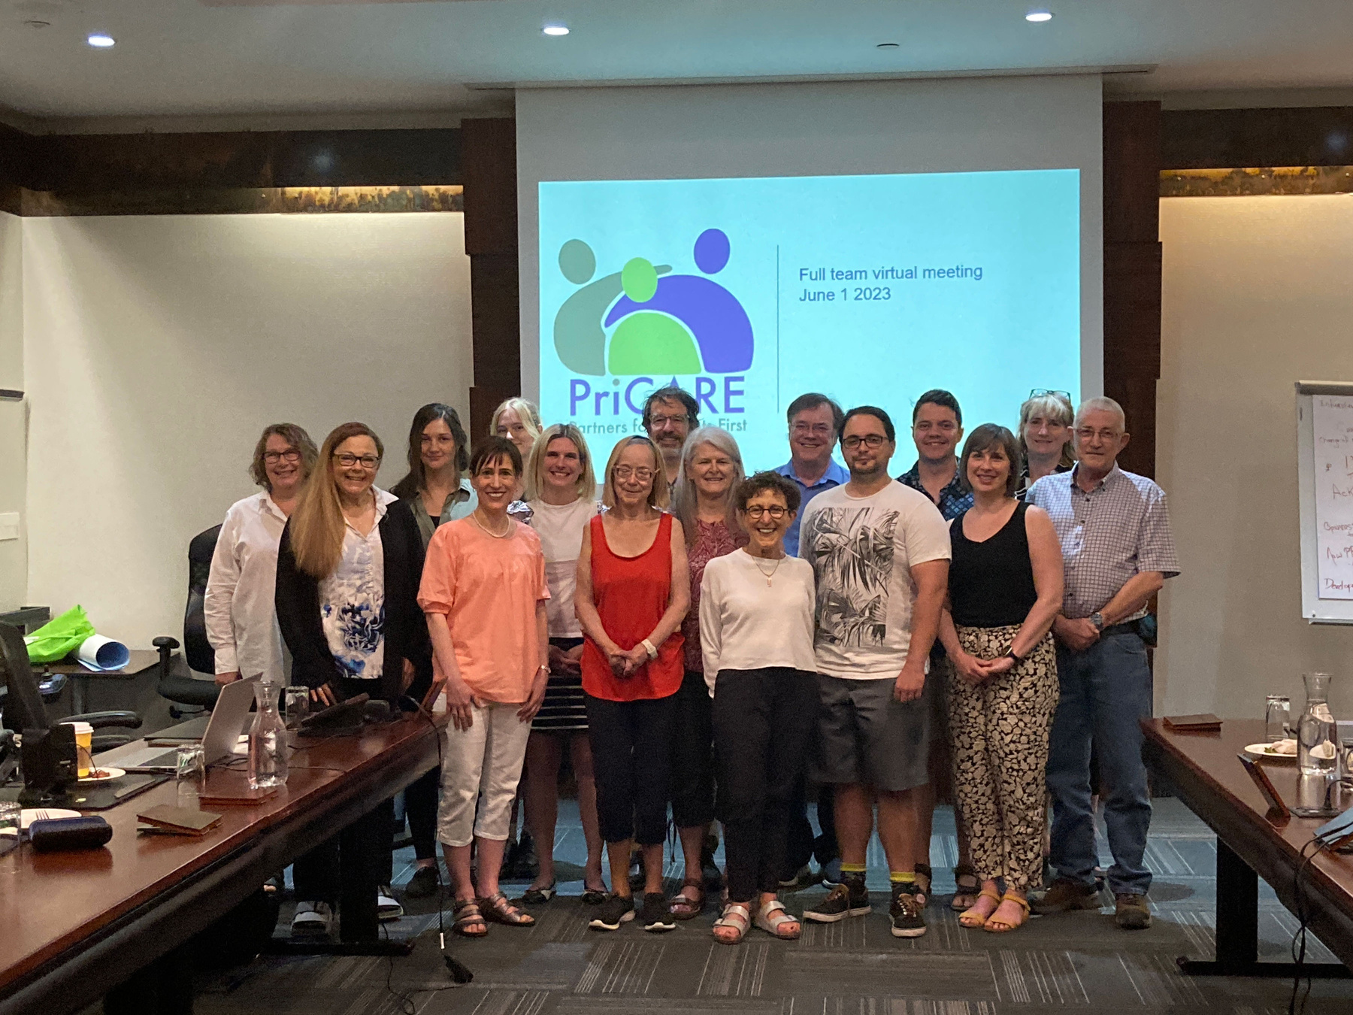
Our team:

Slide 5

PRICARE 1
PRICARE 2
PRICARE INTEGRATION
Aim:
Implement and evaluate a CM intervention in primary care clinics for patients with complex care needs.
Jurisdictions involved:
Quebec, New Brunswick, Newfoundland and Labrador, Nova Scotia and Saskatchewan
Aim:
Spread CM across Canada and better understand the role of external facilitation in implementation of complex interventions.
Jurisdictions involved:
Quebec, New Brunswick, and Newfoundland and Labrador
Aim:
Scale-up CM in primary care for people with complex needs and generate new findings on scale up.
Jurisdictions involved:
Quebec, New Brunswick, and Nova Scotia

Slide 6

PriCARE 1

Slide 7



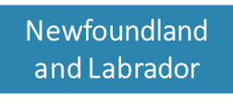





What have we done so far?
  CM was implemented in primary care clinics in various provinces.
  Implementation analysis was conducted.
  Realist evaluation of case management was conducted.

Slide 8
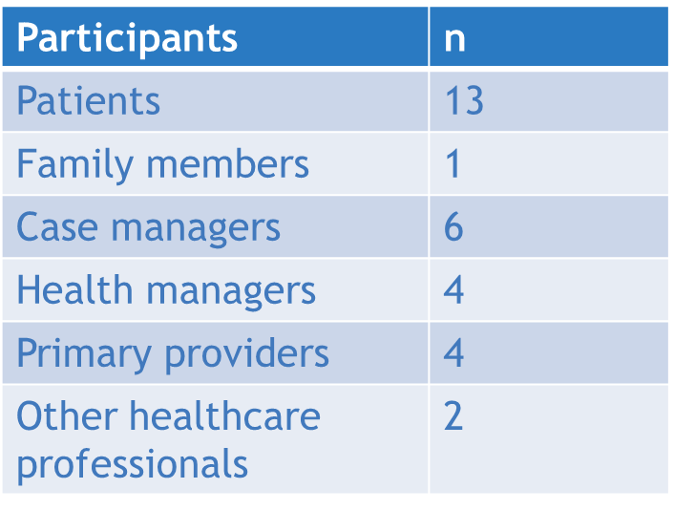

Realist evaluation:
  Realist evaluation was conducted to evaluate the intervention and refine the program theory to inform how case management works, for whom and under what circumstances.
  Individual interviews (n=27) and focus group (n=1) with 3 providers.
  Data from Quebec, Newfoundland and Labrador, Nova Scotia and New Brunswick.

Slide 9

CMO Configuration:
CONTEXT (C)
Background of the program
that triggered the
mechanism: Informants’
characteristics,
Interpersonal
relationships,
social, economic
and political
contexts and
structures
MECHANISM (M)
Reasoning, attitudes and behaviors of the various actors in relation to the program, that triggered the outcome
OUTCOME (O)
Impact of the relationship between the context and the mechanism
  Figure adapted from Pawson and Tilley, 1997

Slide 10
Refined program theory:
Patients
Feel supported, respected and accepted
Feel engaged and committed
Are more knowledgeable and empowered
Family members
Feel supported, respected and accepted
Case managers
Feel confident to develop their role
Feel accountable to the patient
Feel supported and become part of the team
CM Program
Collaborative team, open to change and valuing case manager role
Access to care
Case managers experience, skills, engagement, and openness to new role
Patient with complex needs
Patients self-management
Demi-regularities: 1) Trusting relationship, patient and engagement and empowerment
2) Case managers’ accountability and engagement
3) Enhanced teamwork
ED visits
Patients physical and mental health
Quality of care
Care coordination
Patients and family members stress and anxiety
Interorganizational collaboration
Legend
Context
Mechanism
Outcome
Clinical skills and knowledge
Workload
Teamwork

Slide 11


Patients have complex needs and difficulty accessing care.
Case managers are skilled and experienced.
Family members feel supported, respected and accepted.
Improved patient health and reduced stress for family members.
.
Patients have complex needs and difficulty accessing care.
Case managers and patients have a trusting relationship.
Case managers are engaged.
Case managers feel accountable to patients and want to do what they can to help them find solutions.
Reduced patients’ stress and anxiety.
Team is open to change.
Collaborative team.
Case manager role is valued.
Case managers feel supported and become part of the team.
Reduced provider workload.
Improved coordination of care.
Improved quality of care

Slide 12

Next Steps:
Under the leadership of the Quebec team, we will work with other provinces to implement PriCARE 2 and PriCARE integration.

Slide 13


PriCARE Integration:
Year 1:
Year 2-5:
.
Realist evaluation of scale up of CM intervention for patients with complex needs.
Refining program theory.
Key steps:
  Clinic onboarding.
  Patient recruitment.
  Realist interviews to identify contexts, mechanisms and outcome configurations.
  Data integration and analysis.

Slide 14

Conclusions
  We have gained valuable experience in working with clinics to implement case management in primary care for individuals with chronic conditions and complex care needs.
  We refined a program theory focusing on what factors make case management work, for whom, and under what circumstances.
  We developed a variety of tools and training materials which will help us in the next stages of implementation.
  Next steps include the spread and scale up of case management across provinces.

Slide 15






















Funding
This work is supported by the Canadian Institutes of Health Research (CIHR) – Operating Grant: SPOR PIHCI Network: Programmatic Grants (grant number 397896) and other partners

Slide 16

THANK YOU!
QUESTIONS?
www.reallygreatsite.com

